Slide 1
PRM393 Review 1
Lecturer:
Mr. Nguyen Minh Sang
Group 3:
Nguyen Huy Hoang
Phung Tuan Minh
Nguyen Phuoc Long Nhat
Truong Tran Gia Bao
Nguyen Thanh Dai

Slide 2
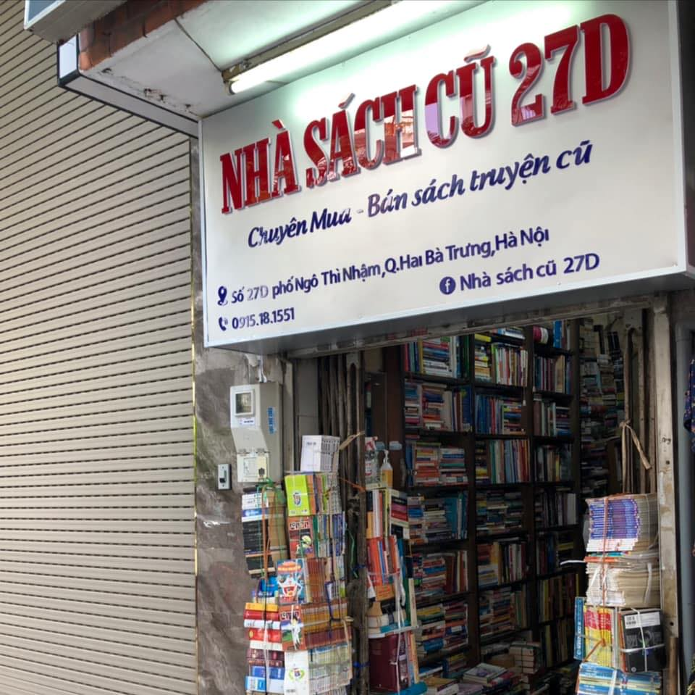

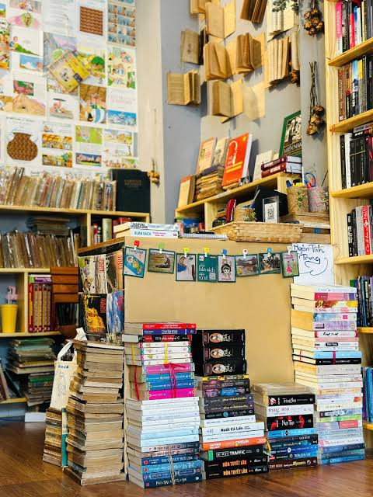



Context
Students have a growing demand for affordable books
Used books are mainly bought and sold through Facebook groups and e-commerce platforms
It is difficult to verify book condition and seller reliability
There is a need for a specialized platform for buying, selling, and exchanging used books
Source: Nhà sách cũ 27D Ngô Thì Nhậm

